Slide 1


SESSION 1 : Briefing About R and RStudio
RANSINGH SATYAJIT RAY

Slide 2
R Programming Language
R is a language and environment for statistical computing and graphics. It is a GNU project which was developed at Bell Laboratories (formerly AT&T, now Lucent Technologies) by John Chambers and colleagues.
R provides a wide variety of statistical (linear and nonlinear modelling, classical statistical tests, time-series analysis, classification, clustering, …) and graphical techniques, and is highly extensible.
https://cran.r-project.org/
Current R version : R-4.1.1
R (Integrated Suite of Software facilities)
Effective data handling and storage facility
A suite of operators for calculations on arrays and matrices
Graphical facilities for data analysis
A large, coherent, integrated collection of intermediate tools for data analysis
Includes conditionals, loops, user-defined recursive functions & input and output facilities.

Slide 3
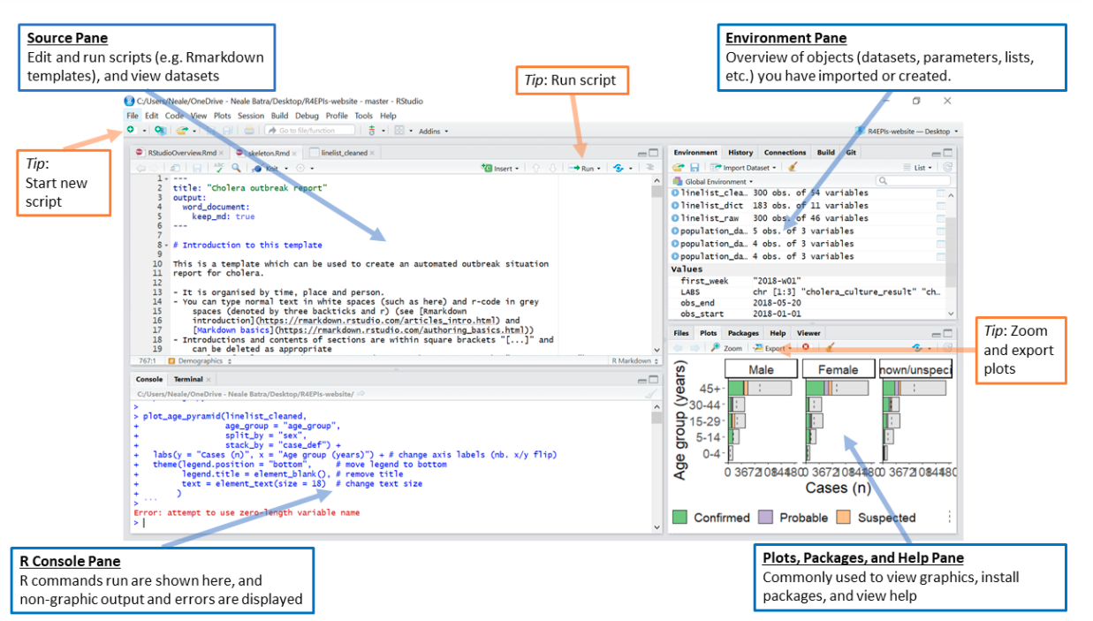
RStudio is an Integrated Development Environment (IDE) for R, a programming language for statistical computing and graphics.
Unlike many other statistical software packages in which a graphical user interface is employed, a typical user interacts with R primarily through the command line.
An IDE for R include a means for issuing commands interactively.

Slide 4
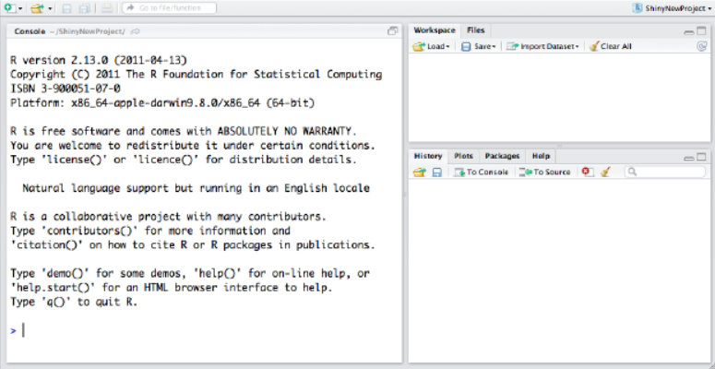
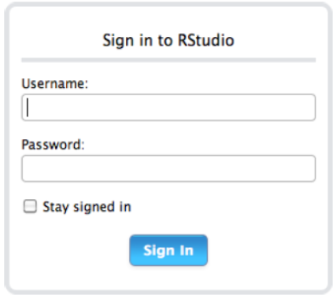
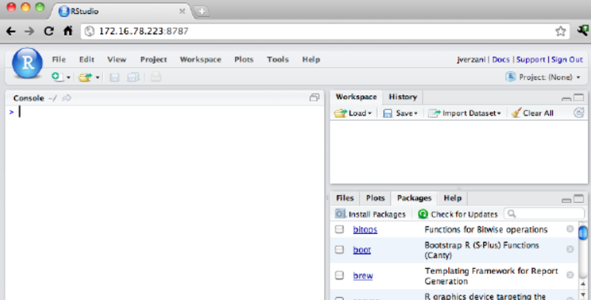
Why RStudio
Easier and more productive to use R
4-panel layout
That includes a console for interactive R sessions,
A tabbed source-code editor to organize a project’s files, and
Panels with notebooks to organize less central components.
Source-code editor is feature-rich
Setting up different projects is a snap, and switching between them is even easier.
Easy-to-use administrative tools for managing packages, the workspace, files, and more.
DESKTOP
SERVER
Console, Workspace, History
Enables you to provide a browser based interface to a version of R running on a remote Linux server,
Mac: Icon in App, Windows: Desktop, Linux: rstudio command

Slide 5
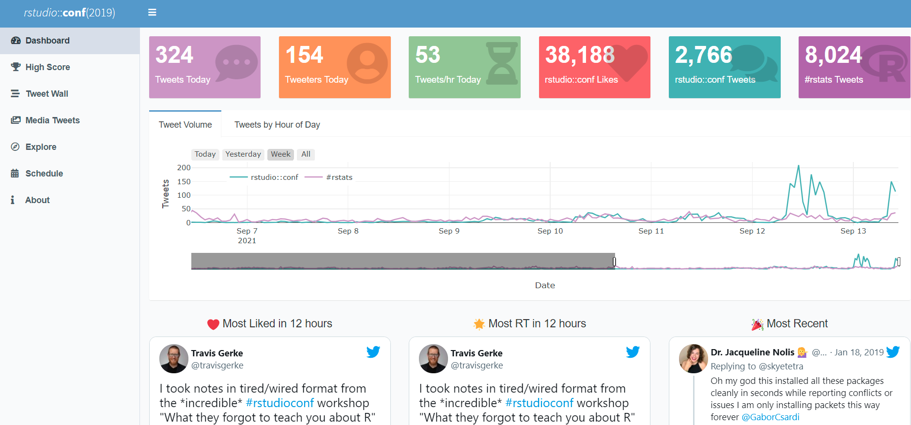
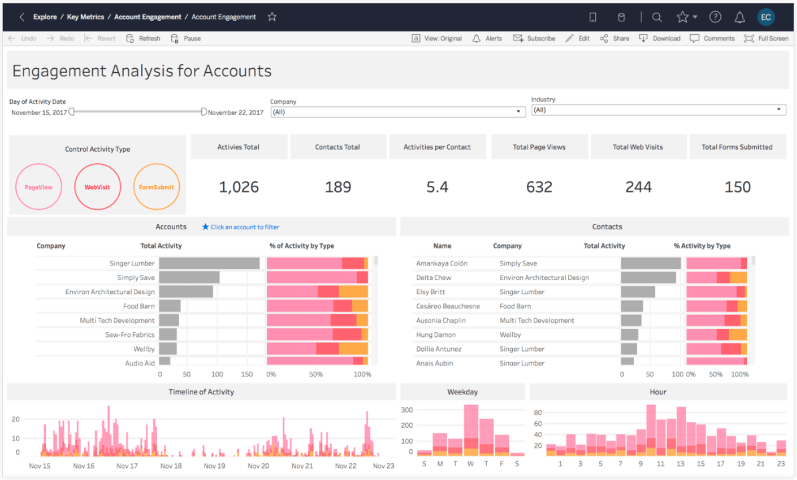
Subtle Comparison with other Tools
R Shiny, flexdashboard
Tableau/Power BI/Qlik View
Source
Source
https://gadenbuie.shinyapps.io/tweet-conf-dash/?_ga=2.121046656.984439988.1631514451-767271589.1623651113
https://www.tableau.com/products/cloud-bi
Pricing >> Free of Cost
Pricing >> 70$ user/month billed annually
R & Shiny combine both Machine Learning & decision making
Cannot do decision making on its own. Its for dashboarding primarily
Application security not limited to terms and condition, can be customized without much cost
Application security limited to terms and condition and customization can be expensive

Slide 6


Vs
Similarities:
Both data science languages are great for business analysis.
Both R and Python can be used in similar capacities when viewed from a pure machine learning perspective.
Both have packages or libraries that are dedicated to wrangling, preprocessing, and applying machine learning to data.
Both are excellent choices for reproducible research, a requirement for many industries to validate research methodologies and experiments.
Dissimilarities:
Developed by Researchers and Scientists
R language with roots in statistics, data analysis, data exploration
Reporting and Communication using Rmarkdown and Shiny.
Developed by Software Engineers
In essence, Python’s roots are in computer science and mathematics.
Excellent from Deep learning Applications

Slide 7
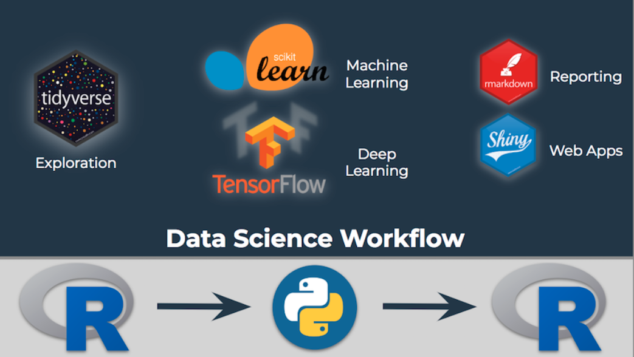
How to leverage best of R and Python

Slide 8
RStudio
R is not unique in this respect, and IDEs for interactive scientific programming languages have matured to include features such as:
CONSOLE
SOURCE CODE EDITOR
OBJECT BROWSER
Development involves the act of programming & this task is inevitably done with a source-code editor.
An object browser allows the user to identify quickly the type and values for each such variable.
A console for issuing commands.
OBJECT EDITOR
DOC INTEGRATION
PLOT MANAGEMENT
A means to inspect or edit objects is typically provided
We can see the documentation
We can manage
the plotting

Slide 9
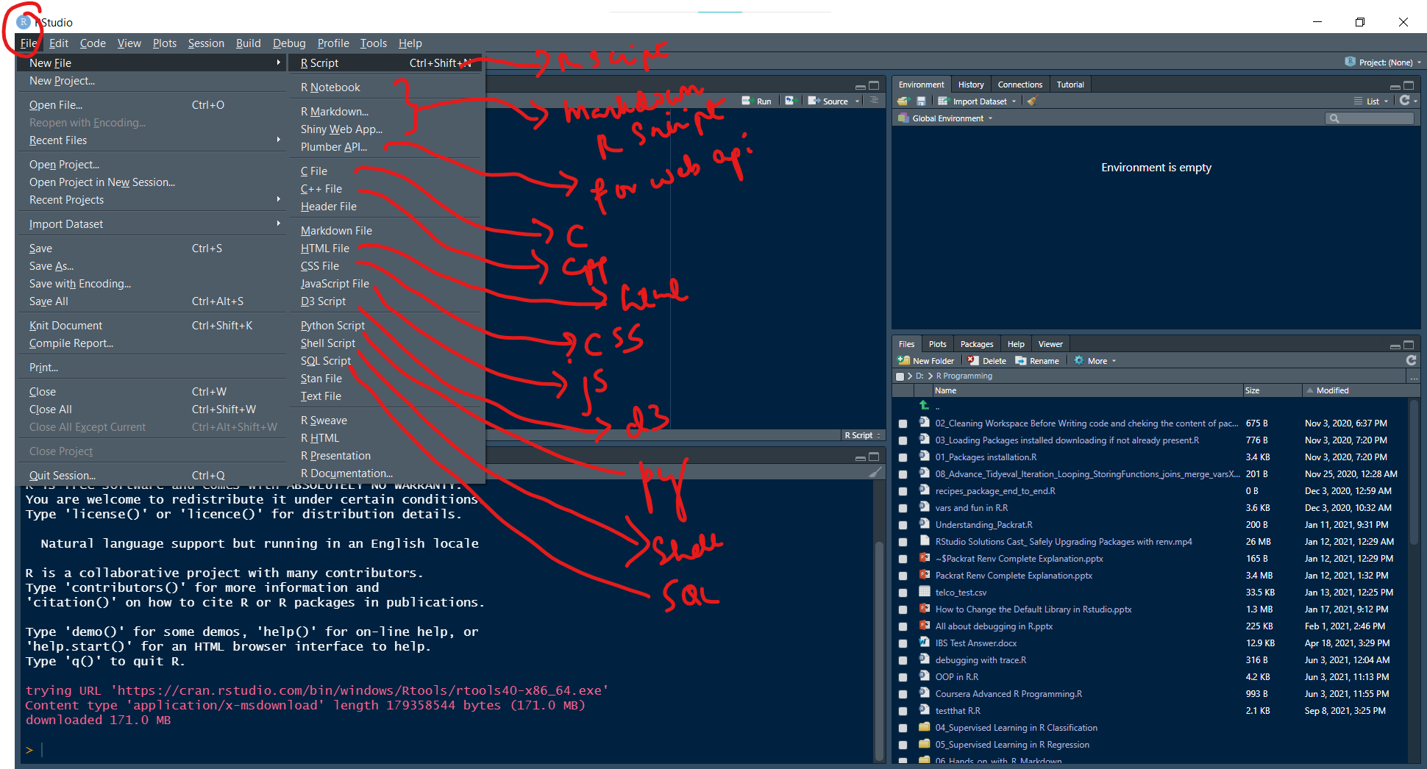
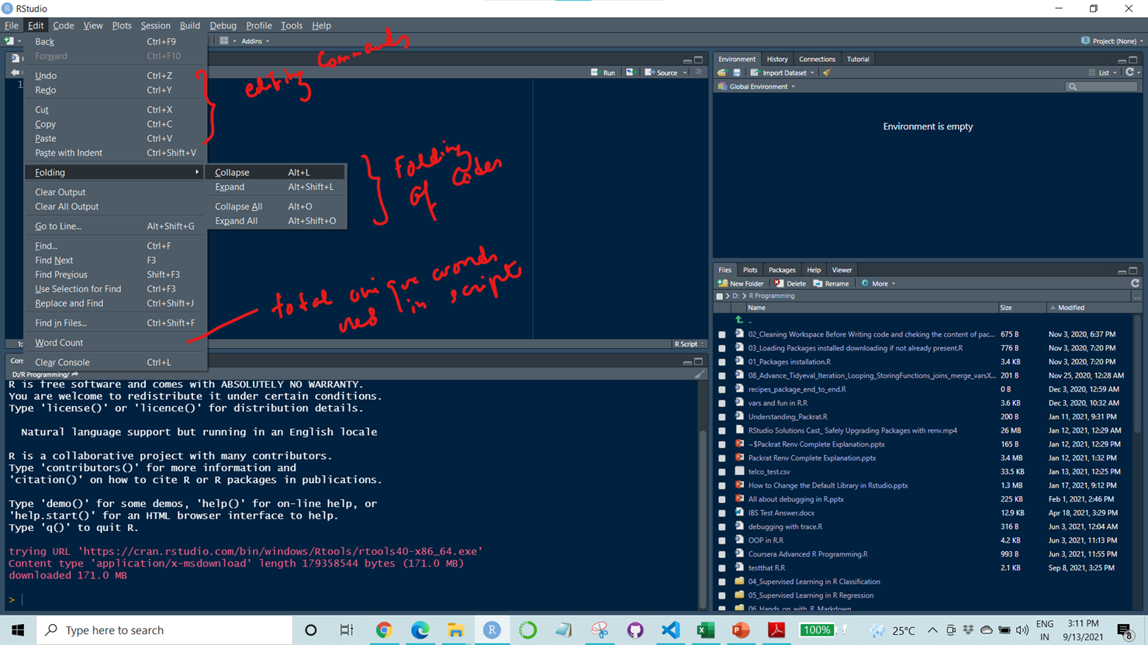
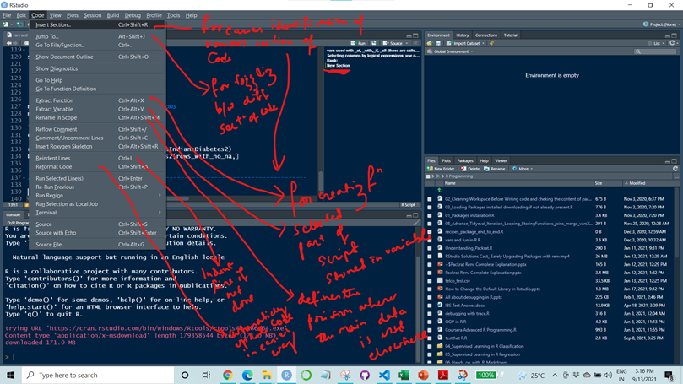
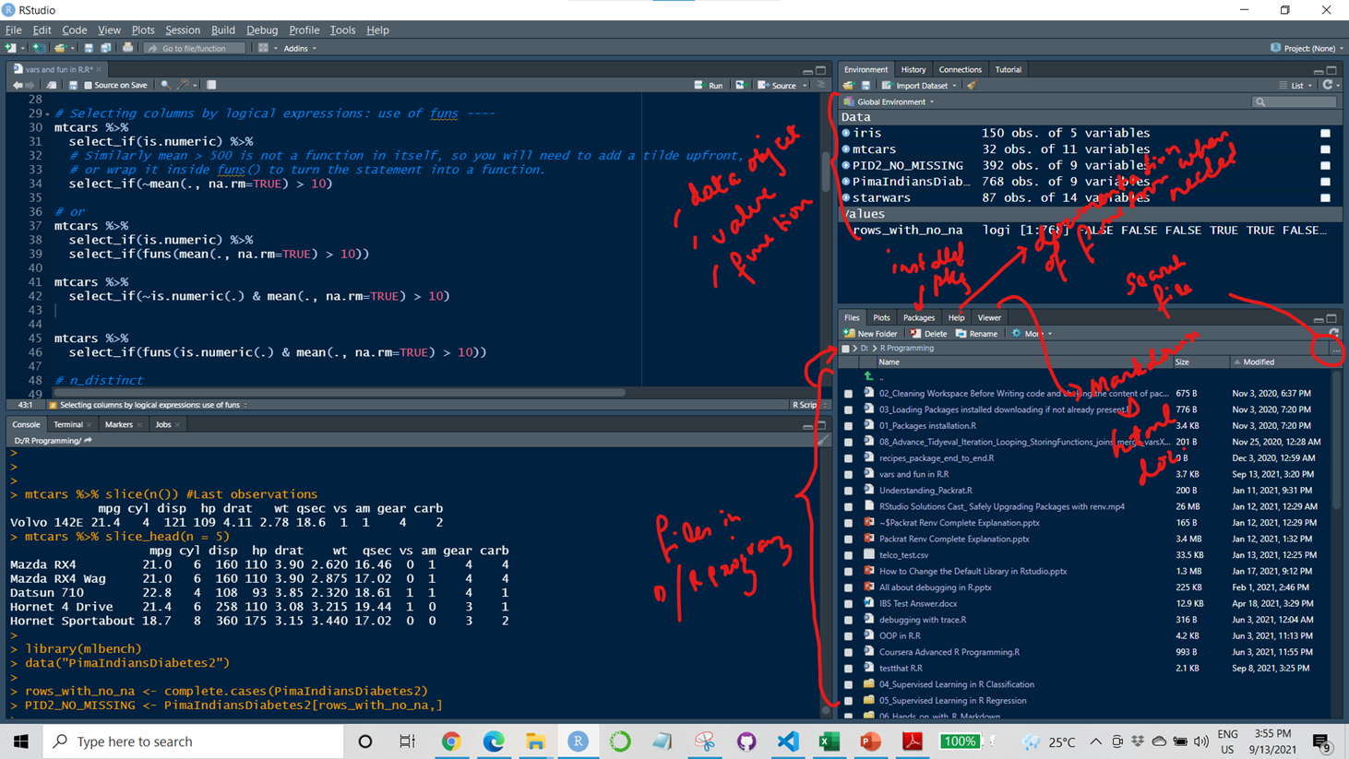
File Tab
Edit Tab
Code Tab
Environment, File/Plots/Pkg/Viewer

Slide 10
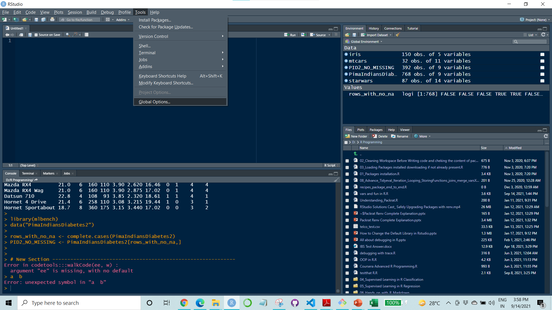
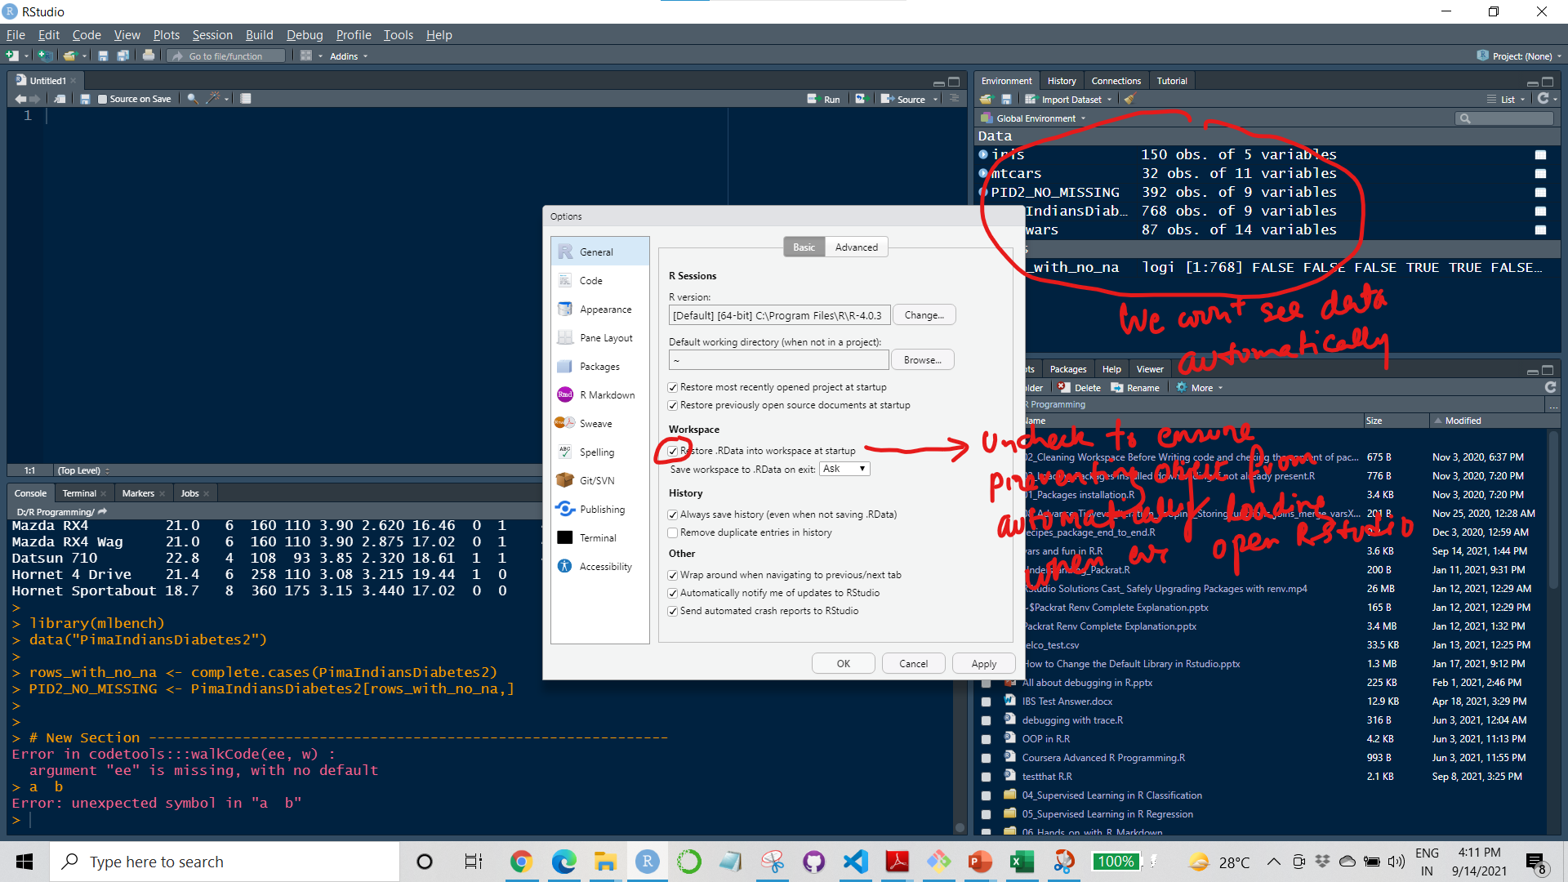
Tools Tab >Global Options…> General
Workspace: Checking/Unchecking the .Rdata Option
If we donot choose that option then whenever we open Rstudio we run rm(list=ls()) to clear the environment first and then I run the necessary scripts if incase using older dataset and object causes issue

Slide 11
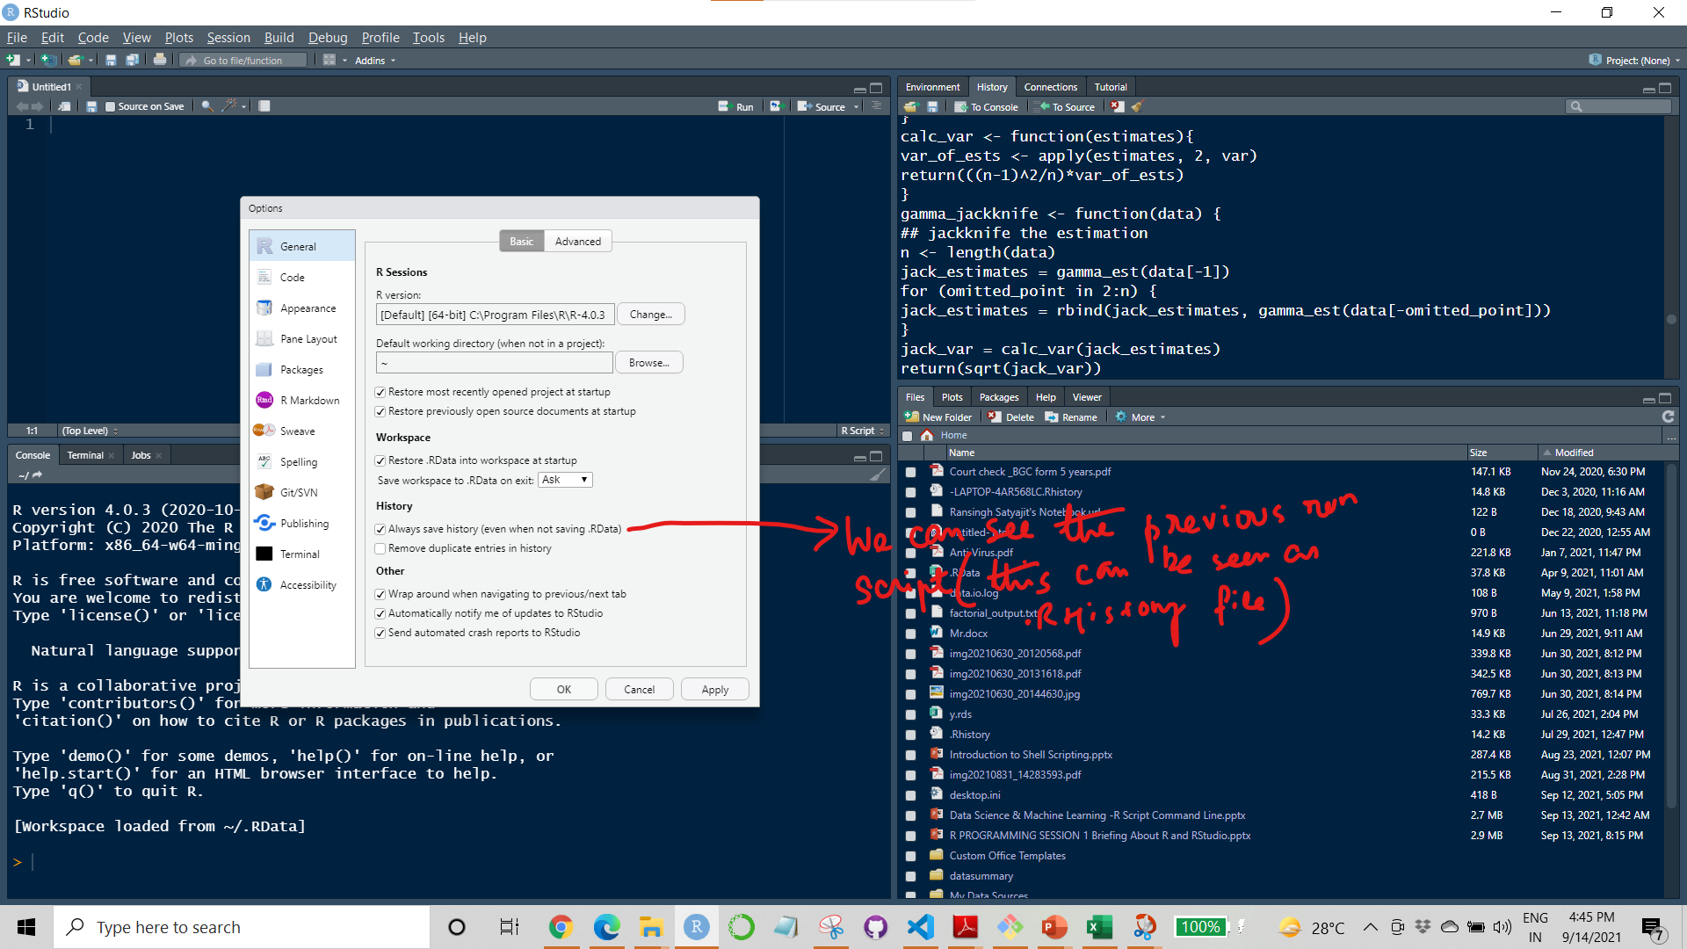
Tools Tab >Global Options…>General
History: Check on Always save history
Always save history (even when not saving .RData) — Make sure that the .Rhistory file is always saved with the commands from your session even if you choose not to save the .RData file when exiting.

Slide 12
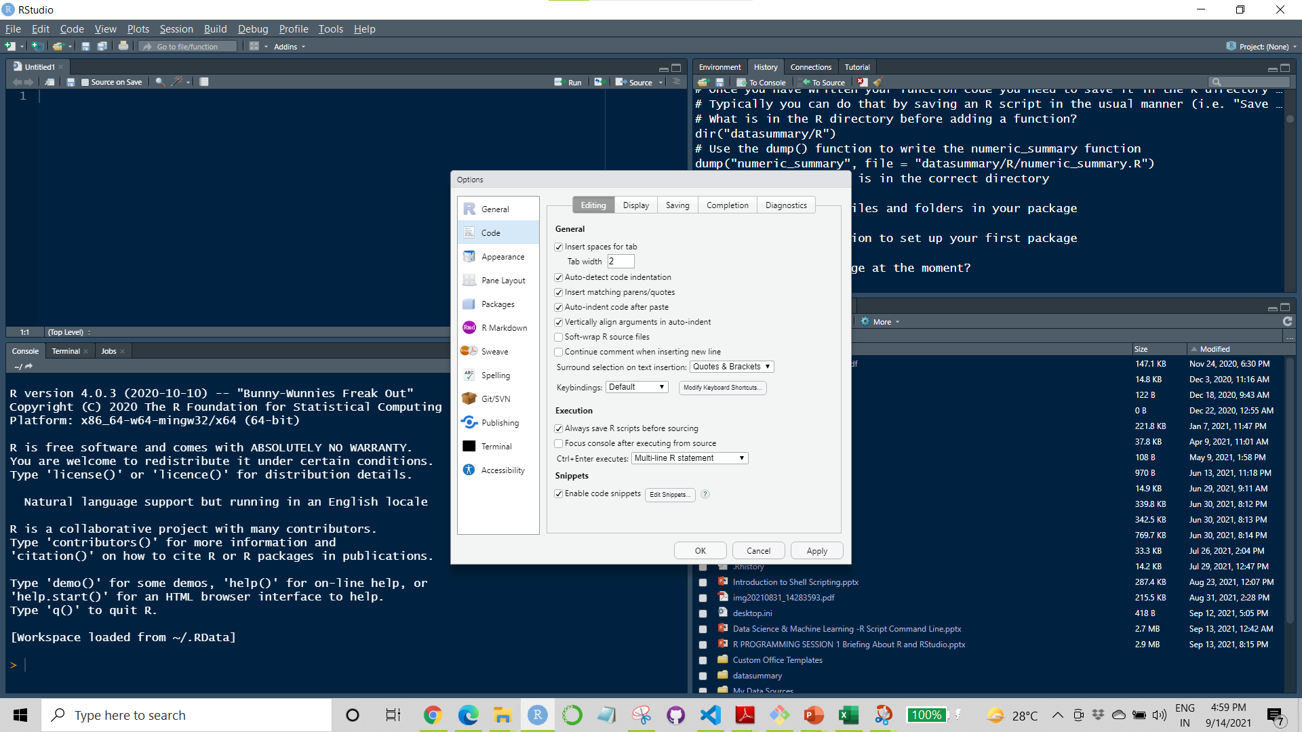
Tools Tab >Global Options…> Code
Leave it as it is. Cosmetic Changes to increase ease of writing code

Slide 13
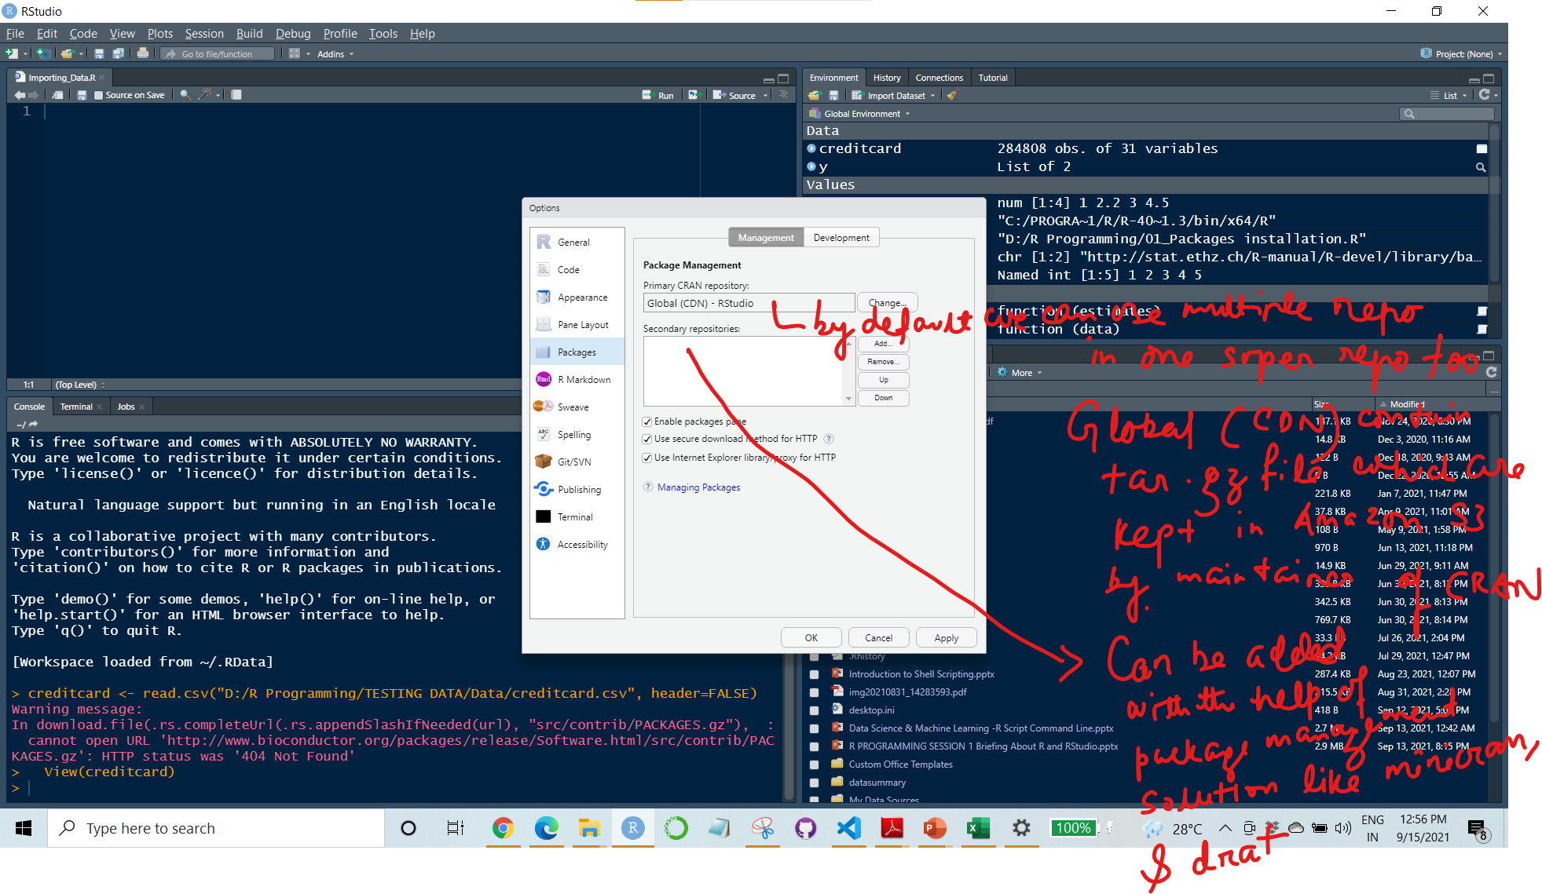
Tools Tab >Global Options…>Packages
Repositories of Packages:
Repository | URL
CRAN | See http://cran.r-project.org/web/packages/ for an authoritative list, but you should try to find your local mirror and use that site instead
Bioconductor | http://www.bioconductor.org/packages/release/Software.html
R-Forge | http://r-forge.r-project.org/
rOpenSci | https://ropensci.org/
function1
function2
function3
Package 1
function1a
function2a
function3a
Package 2
Package2
Package1
Repository of Package
Package3

Slide 14
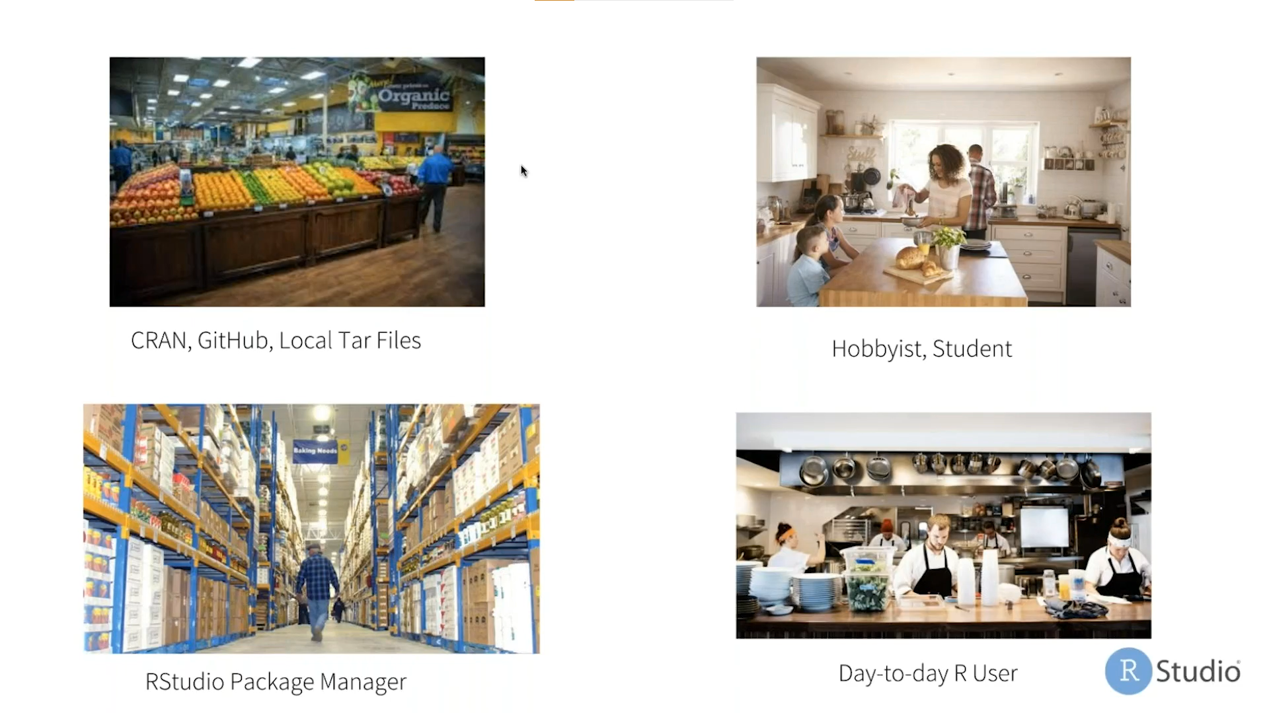
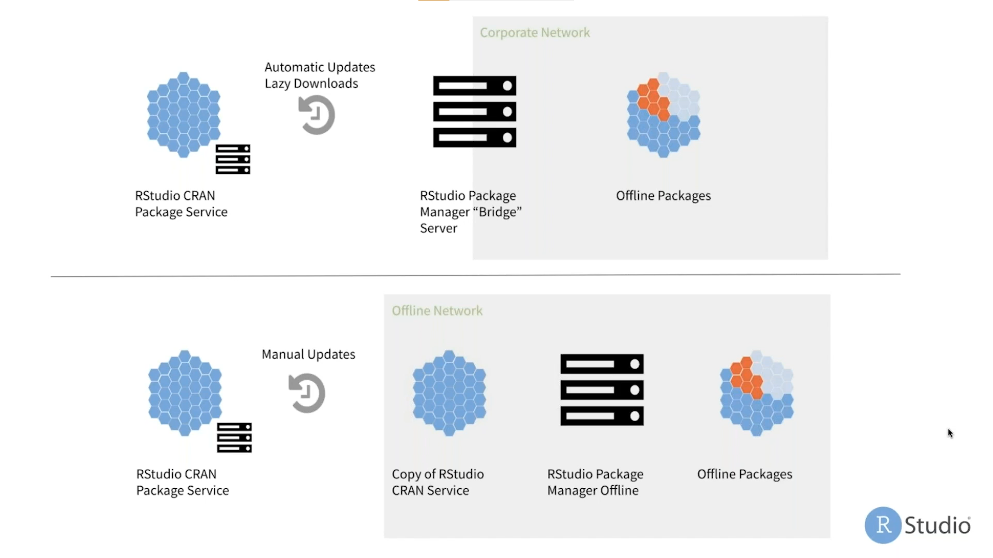
Packages and Package Management

Slide 15
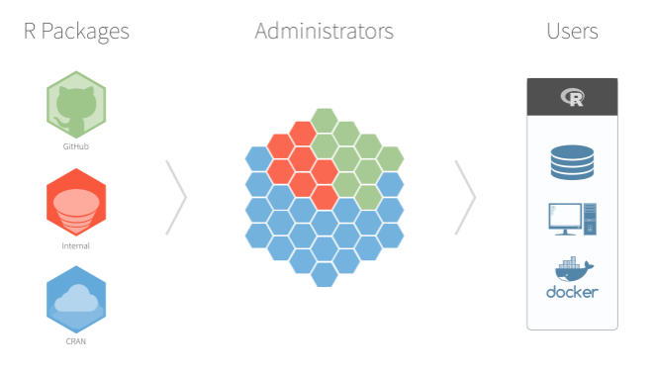
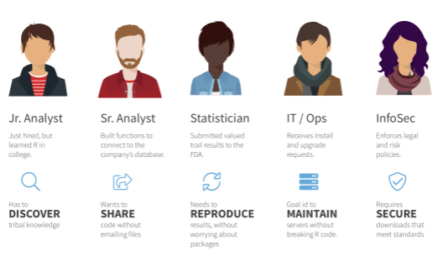
Tools Tab >Global Options…>Packages
RStudio Package Manager is an on-premises server product that allows R users and IT to work together to create a central repository for R packages.
RStudio Package Manager supports your team wherever they run R, from bash scripts and Docker containers to RStudio, RStudio Server (Pro), Shiny Server (Pro), and RStudio Connect.
https://www.r-bloggers.com/2018/10/announcing-rstudio-package-manager/

Slide 16
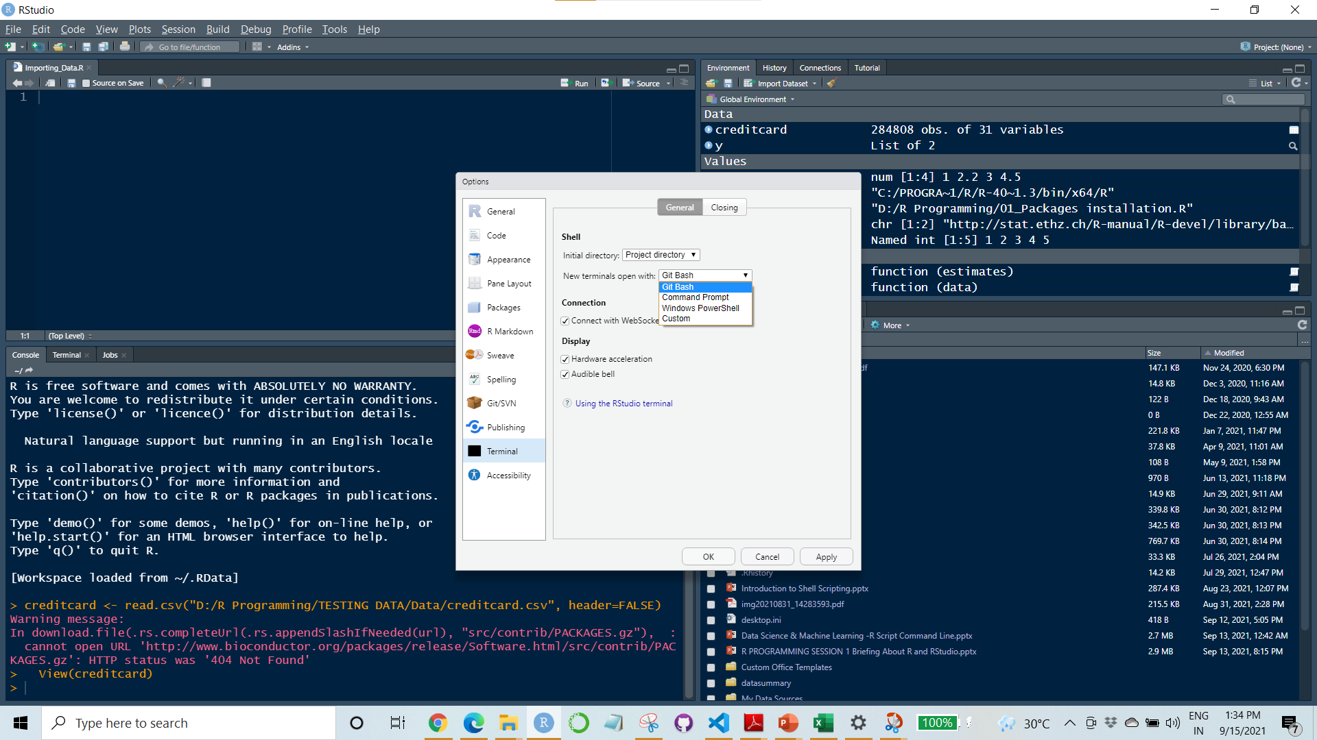
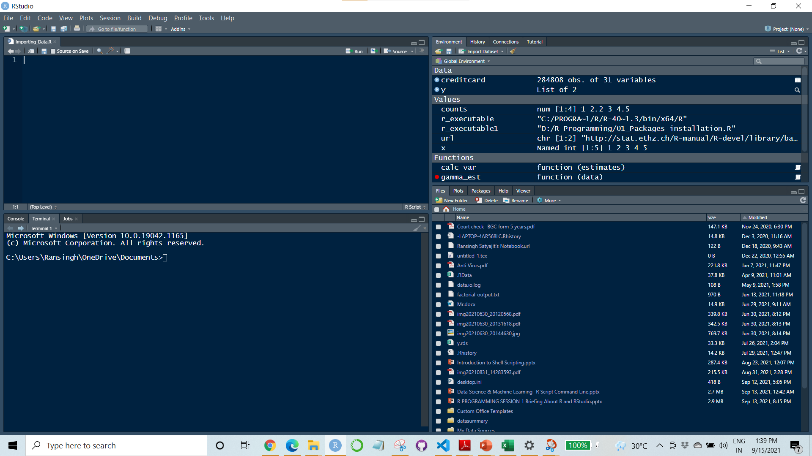
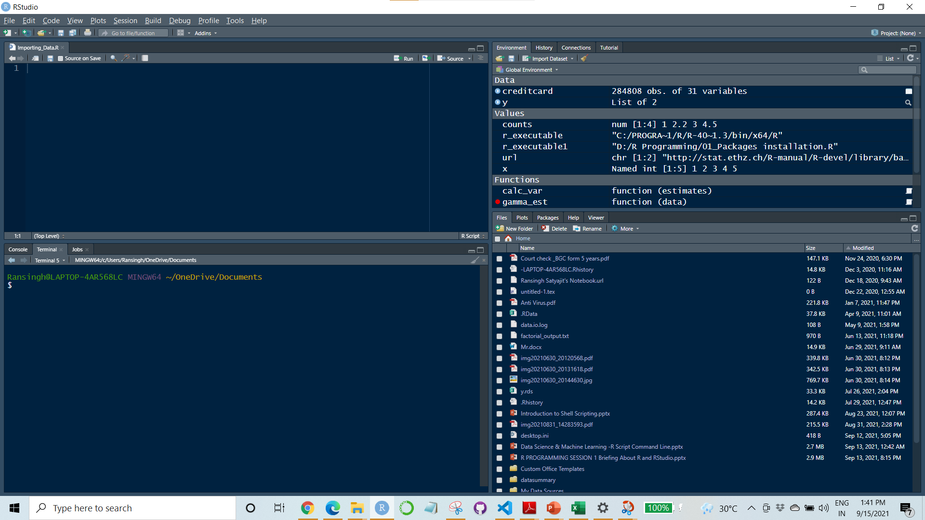
Global Options > Terminal
Controlling the Terminal
Command prompt terminal
Bash scripting terminal

Slide 17
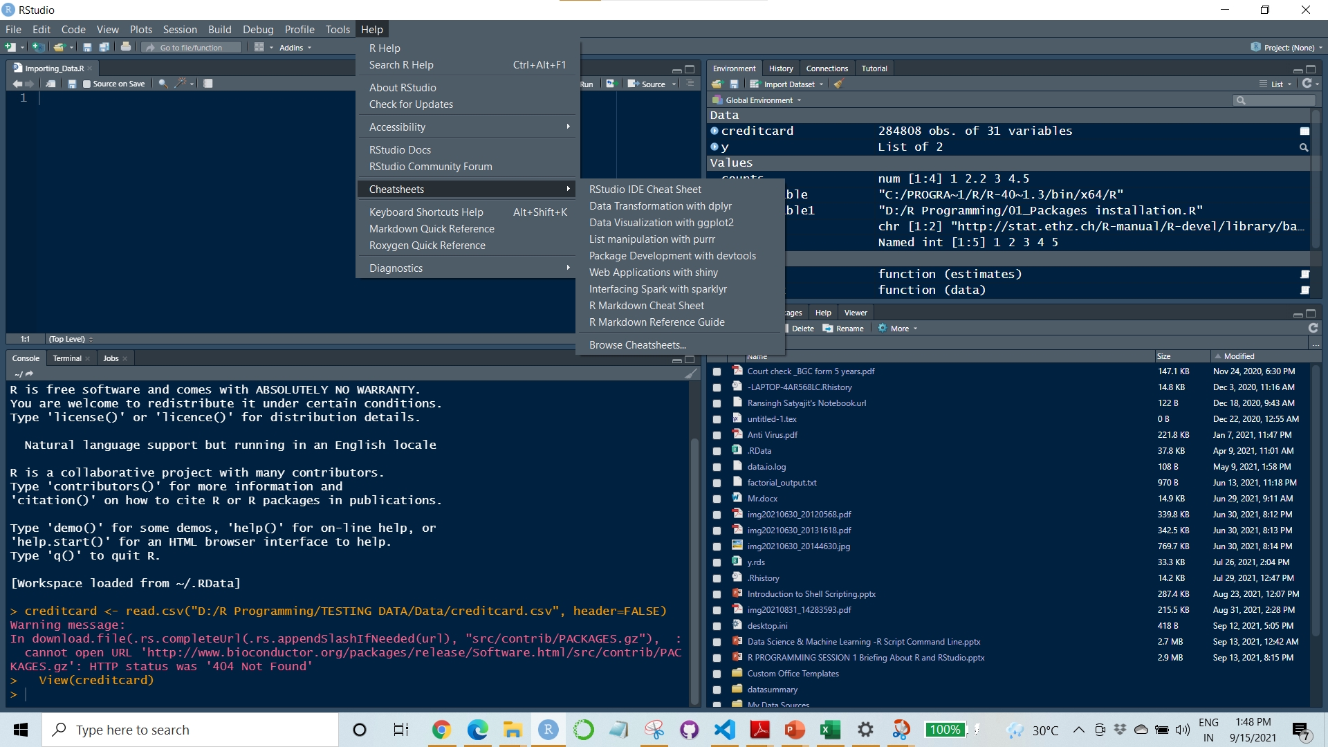
Help Tab
We can look into various things to increase our effectiveness to write the code
Rstudio Docs
Keyboard Shortcuts
Cheat Sheet

Slide 18
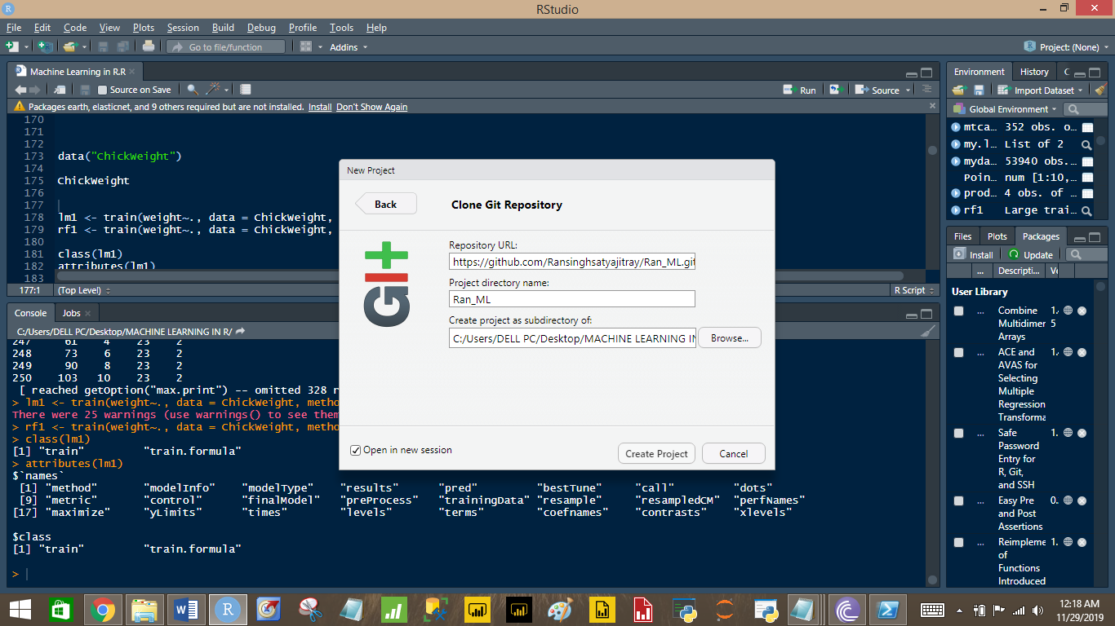
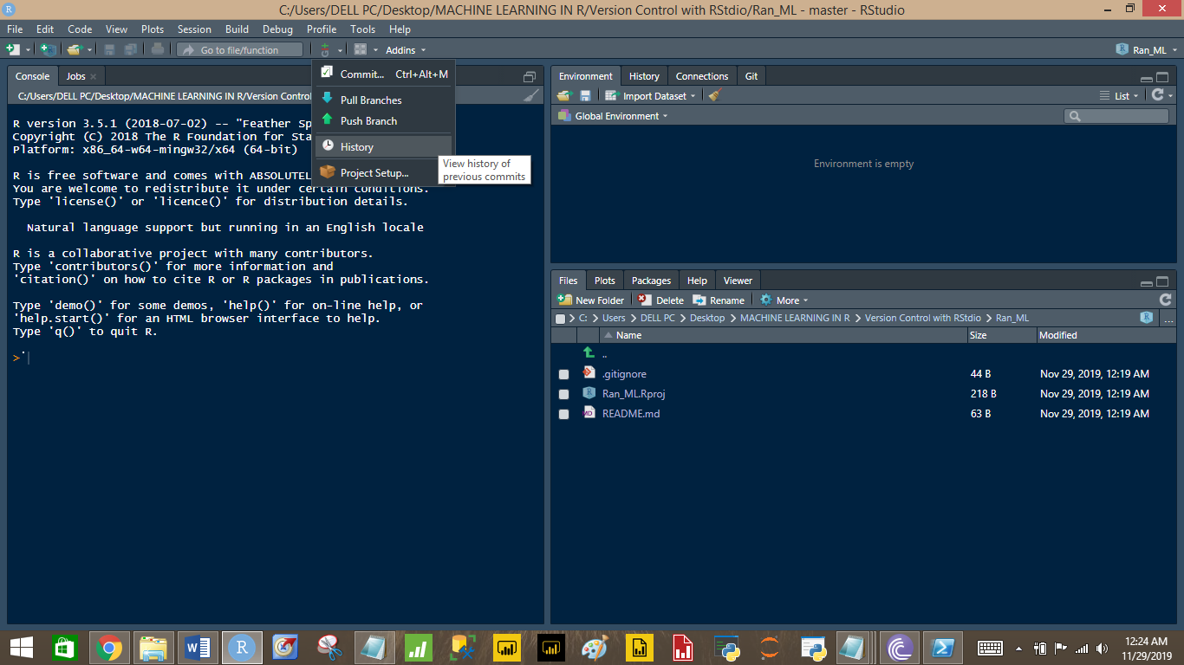
GIt
Rstudio has the option of maintaining the version history of a project through the Git.
Version history is usually maintained using the Git Bash for better ease as Git Bash involve writing git based codes rather than following GUI based option available through Rstudio.
We can use the Git Bash option in terminal or Git Bash application separately.

